Slide 1
Preliminaries
Introduction to Principles of Distributed Systems

Slide 2
Class Stuff
Attendance - You must come to class AND participate
Exams - Based on algorithms and exercises from book
Labs - Programming assignments (some single, some pair-programming) based on algorithms from book
Project - Open-ended (i.e., you pick the project and teammates)
Incentive - Above and beyond
Criteria | Weight
Attendance | 5%
Chapter Exams | 25%
Labs | 25%
Small Homework | 10%
Project | 25%
Incentive | 10-??%

Slide 3
late policy
95% for work submitted up to 2 hours late
90% for work submitted up to 12 hours late
80% for work submitted up to 24 hours late
70% for work submitted up to 2 days late
60% for work submitted up to 3 days late
50% for work submitted up to 6 days late
0% for work submitted more than 7 days late

Slide 4
What we will and will not cover
Will cover:
Distributed Algorithms
Fault Tolerant Distributed Programming
Multi-threading
Socket programming
Network programming, modular programming using Appia Framework
Will NOT cover:
Latest and greatest distributed systems tools (MAYBE a few…)
Some basics you should know (Java, Unix environment, etc.)
Elementary knowledge about algorithms, first-order logic, programming languages, security, and operating systems might be helpful but not required

Slide 5
Course Goals
Systems requirement:
Learn something about distributed systems in particular;
Learn general systems principles (modularity, layering, naming, security, …) and the algorithms on which they work
Practice implementing real, larger systems and distributed tools used to implement those systems

Slide 6
Why take this course?
Huge amounts of computing are now distributed...
A few years ago, Intel threw its hands up in the air: couldn’t increase GHz much more without CPU temperatures reaching solar levels
But we can still stuff more transistors (Moore’s Law)
Result: Multi-core.
Result 2: Your computer has become a parallel/distributed system. In a decade, it may have 128 cores.
Oh, yeah, and that whole Internet thing...
my phone syncs its calendar with google, which i can get on my desktop with a web browser, ...
(That phone has the computing power of a desktop from 10 years ago and communicates wirelessly at a rate 5x faster than the average american home could in 1999.)
Stunningly impressive capabilities now seem mundane. But lots of great stuff going on under the hood...
Most things are distributed, and more each day

Slide 7
If you find yourself…
In hollywood....
... rendering videos on clusters of 10s of 1000s of nodes?
Or getting terabytes of digital footage from on-location to post-processing?
On wall street...
tanking our economy with powerful simulations running on large clusters of machines
For 11 years, the NYSE ran software from cornell systems folks to update trade data
In biochem...
using protein folding models that require supercomputers to run
In gaming...
Writing really bad distributed systems to enable MMOs to crash on a regular basis
not to mention the obvious places

Slide 8


Slide 9
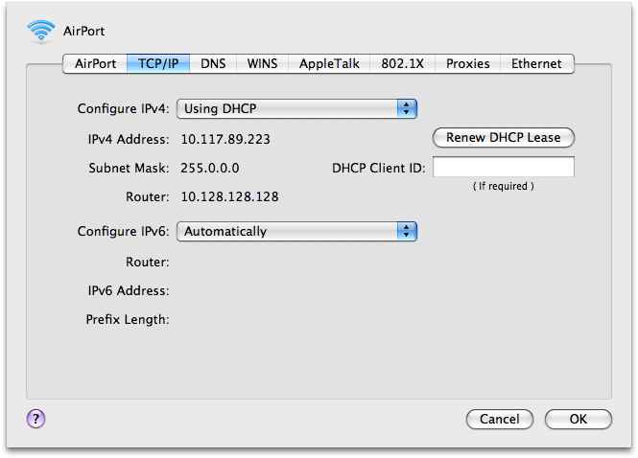


Slide 10

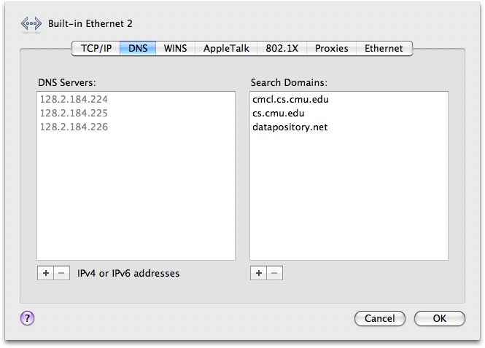

Remember IP...
hosts.txt
www.google.com 66.233.169.103
www.cmu.edu 128.2.185.33
www.cs.cmu.edu 128.2.56.91
www.areyouawake.com 66.93.60.192
...
From: 128.2.185.33
To: 66.233.169.103
<packet contents>

Slide 11
The Google Example
Note that URL: www.google.com
But your computer has an IP address...
Naming! The “Domain Name System”, or DNS, translates names to IP addresses
In the days of yore, this was a text file called “hosts.txt” that everyone periodically downloaded
Today, with hundreds of millions of domains...
It’s a big distributed system that allows people to update small parts (“moo.cmcl.cs.cmu.edu”) without coordinating with the owners of other parts. We’ll see this soon.

Slide 12
Domain Name System
. DNS server
Rose DNS server
`
who is www.google.com?
ask the .com guy... (here’s his IP)
who is www.google.com?
`
`
.com DNS server
ask the google.com guy... (IP)
www.google.com is 66.233.169.103
Decentralized - admins update own domains without coordinating with other domains
Scalable - used for hundreds of millions of domains
Robust - handles load and failures well
`
who is www.google.com?
66.233.169.103
google.com DNS server

Slide 13
But there’s more...
Which google datacenter is 128.2.53.5 closest to?
Is it too busy?
who is www.google.com?
128.2.53.5
`
Search!
66.233.169.99
google.com DNS server

Slide 14
A Google Datacenter

Slide 15
How big? Estimates range from 200-500k machines
but it’s not that bad...
usually don’t use more than 20,000 machines to accomplish a single task.

Slide 16
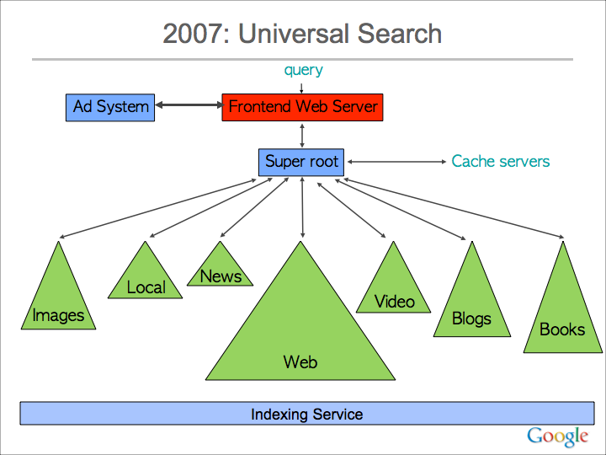
slide from Jeff Dean, Google

Slide 17
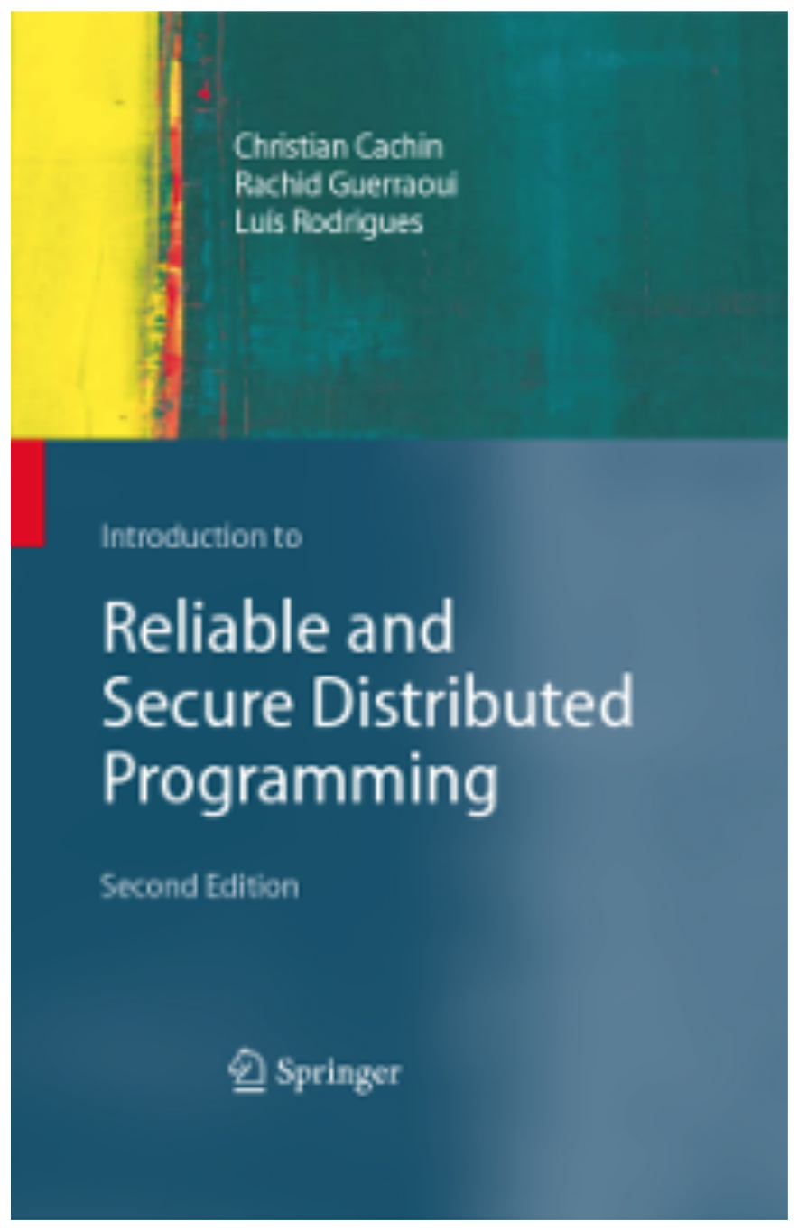
book

Slide 18
what is a distributed system???
Informally: A group of separate, concurrently running processes (robustly) cooperating on a common task (typically using process-to-process communication) despite:
process failures
disconnections of some processes
malicious attacks
synchrony issues
…
Distributed algorithms should thus be dependable, offer reliability and security, and have predictable behavior even under negative influence from the environment

Slide 19
Environment
Can range from multiple processes on a single computer to a datacenter to a global, always-on system
Some systems can be traditional client-server based architecture
Most of the time, it is more “like” a peer-to-peer architecture

Slide 20
Cooperation
What revealed the interesting problems we will be looking at
To quote Leslie Lamport (the father of distributed systems):
“A distributed system is one in which the failure of a computer you did not even know existed can render your own computer unusable.”

Slide 21
Modularity and abstractions
It is much easier to break up the various algorithms into modules
Our job is made easier if the difficulty of robust cooperation is encapsulated within specific abstractions (i.e., encapsulation)
Also known as a “layered approach”
Bridge the gap between lowest layer (the network layer that is used for communication) to the highest layer (the application layer)
The stuff in between is the messy and complicated distributed systems layers (e.g., reliable broadcast/multicast, consensus, shared memory)

Slide 22
distributed system model
We call the set of initial abstractions that an algorithm takes for granted a distributed-system model
The distributed algorithms we study not only differ according to the actual abstraction they implement, but also according to the assumptions they make on the underlying distributed environment
Many aspects have a fundamental impact on how an algorithm is designed
Reliability of the links
Degrees of synchrony of the system
Severity of the failures
Deterministic or randomized solution?

Slide 23
implementations
In many cases, the same basic distributed programming primitive is implemented in multiple distributed-system models
Creates insight into the specific problems encountered in a particular system model
Illustrates how the choice of a model affects the implementation of a primitive

Slide 24
basic Abstractions
Processes
Links
Timing Modules (e.g., failure detectors)
Cryptography

Slide 25
Programming abstractions
Sequential Programming
Array, record, list, …
Concurrent Programming
Thread, semaphore, monitor…
Distributed Programming
Reliable Broadcast
Shared Memory
Consensus
Atomic Commit
…

Slide 26
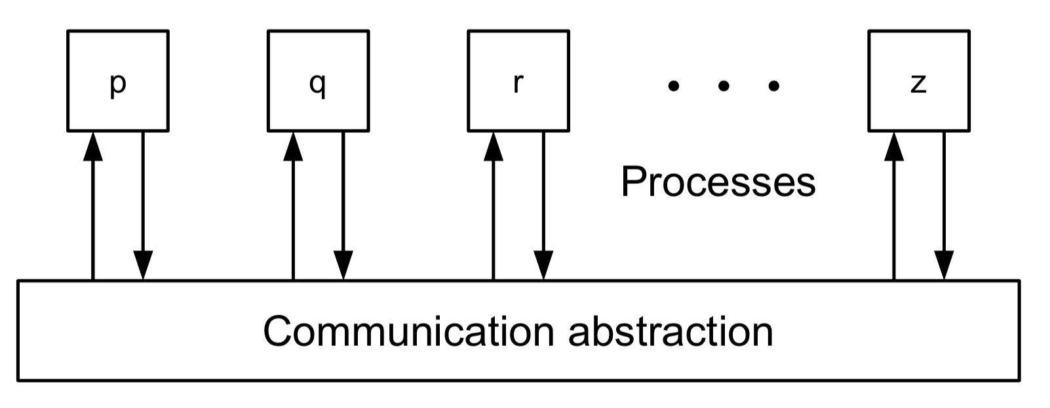
Distributed programming abstractions
Coordination among N identical processes
Processes are also called replicas
Processes jointly implement application
Need coordination

Slide 27
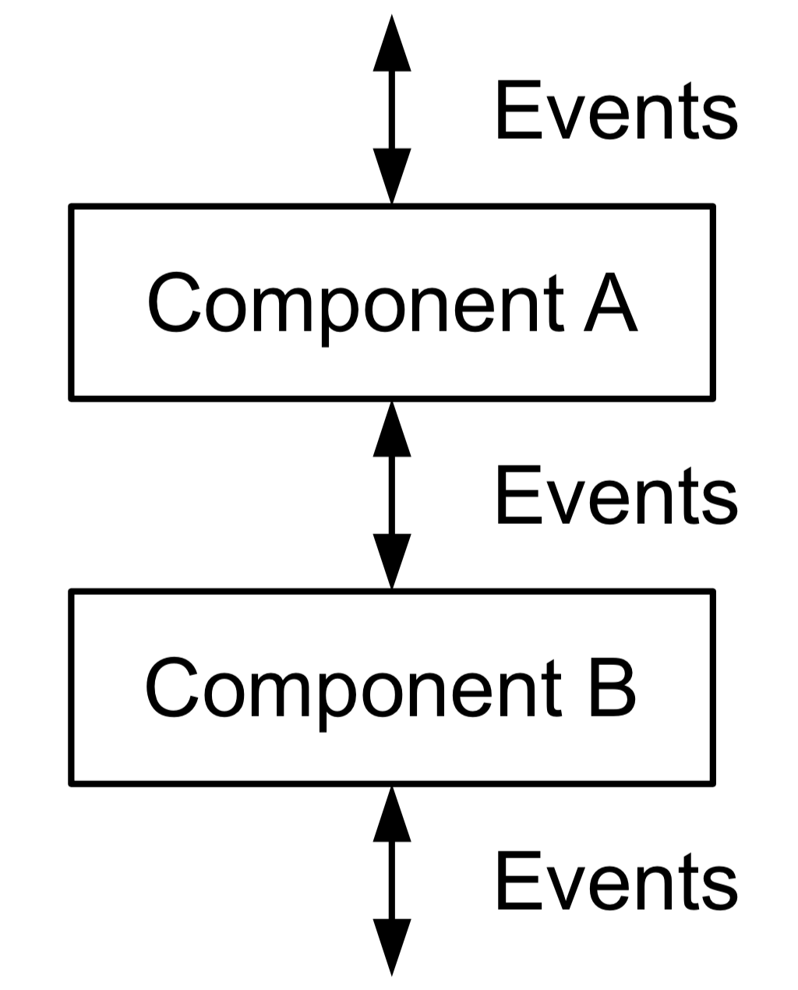
Layered modular
architecture
Every process consists of modules
Modules may exist in multiple instances
Every instance has a unique identifier
Modules communicate through events

Slide 28
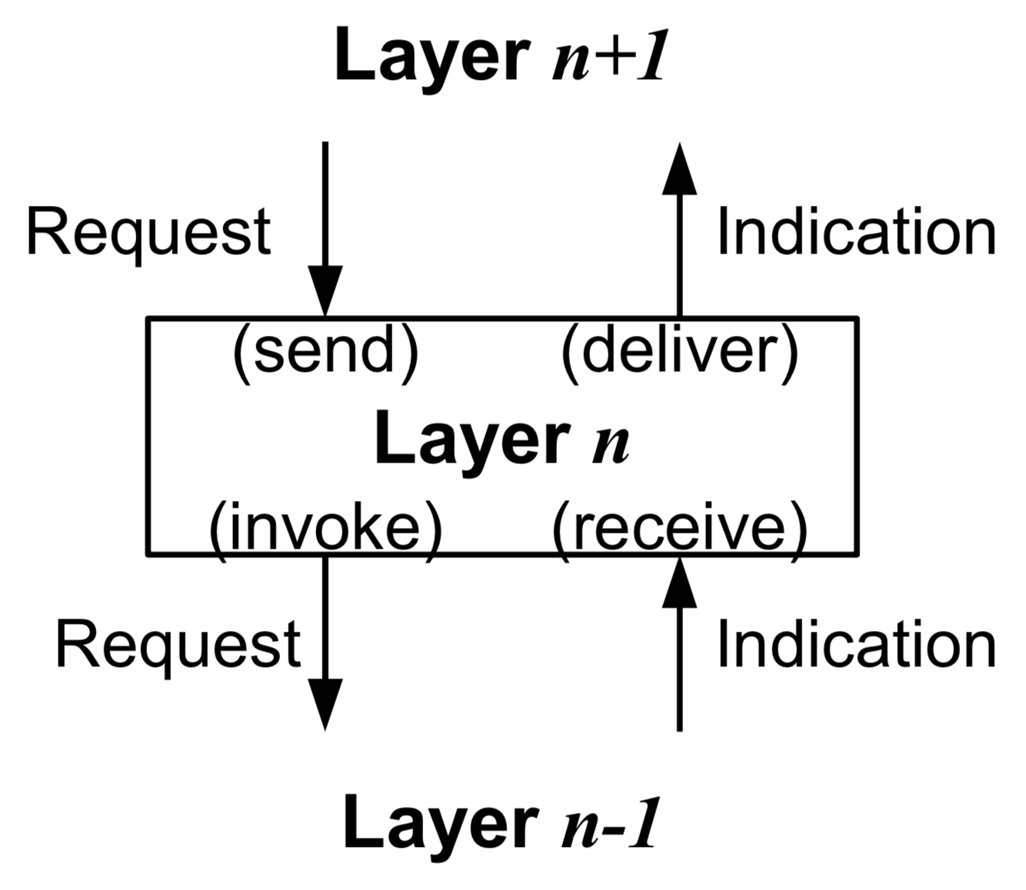
programming with events
Modules are arranged layers of a stack
Asynchronous events represent communication or control-flow
Request events flow downward
Indication events flow upward

Slide 29
processes
System with N processes Π = {p, q, r, …}
Processes know each other
Every process consists of a set of modules and interacts through events
Reactive programming model
upon event <mod, Event | att1, att2 ...> do
do something; trigger <mod', Event' | att'1, att'2 ...>;

Slide 30
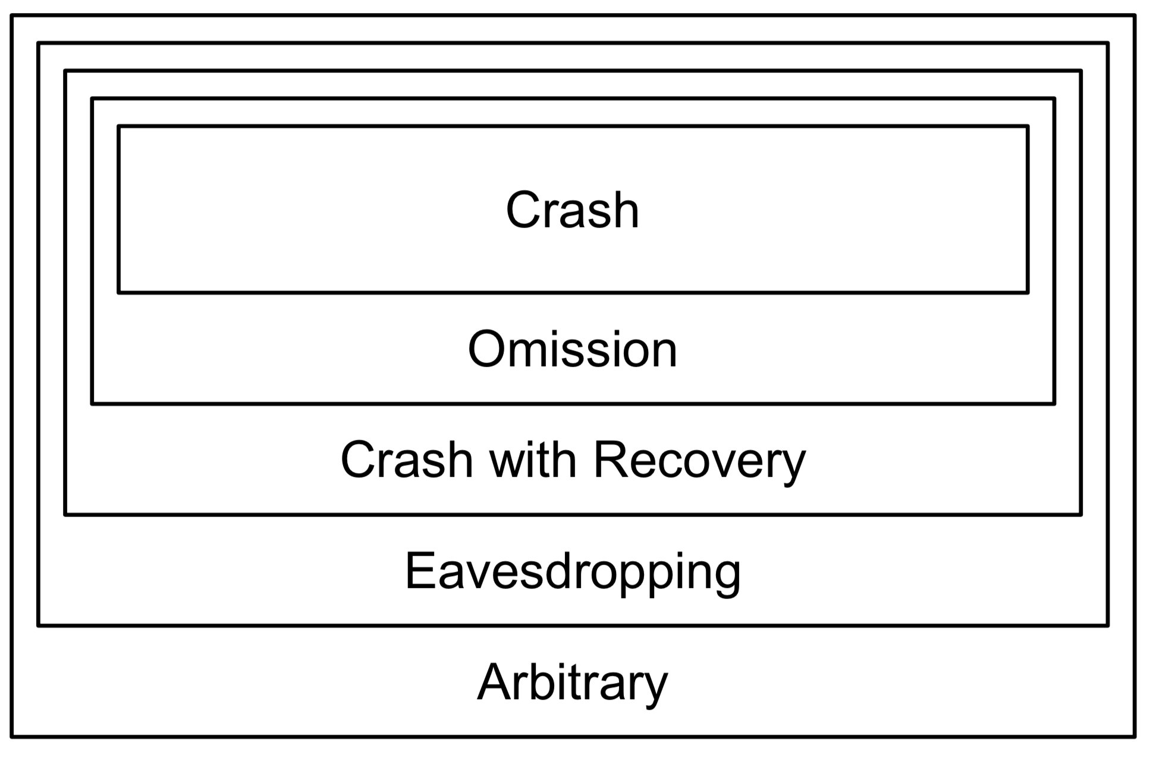
Process failures

Slide 31
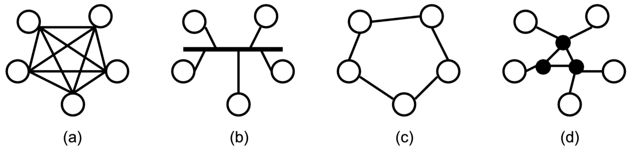
Links
Logically, every process may communicate with every other process as in (a)
Physical implementation may differ (b) — (d)

